Slide 1
Bangladeshi Student’s Abroad Database Management System
Course Title : Database Systems, Course Code : CSE 211, Section : C
1

Slide 2
Description
A government institution in Bangladesh is seeking data related to all students who have studied or studying abroad from their country, along with details about their educational journeys. Their primary focus is on students. Each Student has a unique student ID, and we maintain records of their personal information, such as their full name, gender, address, email, phone number, and passport ID. We track our students' progress in their academic programs. Each student can have multiple Academic Profiles, which include details like the study program name, the year of accomplishment of that study program, and their grade or credit earned on that program of study. Some of their students do Abroad Journey for educational purposes. We keep track of the start year and end year for each journey. Many students can travel abroad in the same year and come back to their home country in the same year. Many journeys can be done to a specific Country; they need details about these countries, like a unique country name and their official language, currency, and time zone. A student may receive multiple Scholarships to go abroad and may not receive any scholarship, and we maintain records of these awards. Each scholarship is assigned a unique scholarship ID and has a corresponding scholarship name. A foreign educational institution can offer various scholarships, and after getting one or many scholarships, their students get admitted to Foreign Institutions for further higher studies. We gather information about these institutions, including a unique institution ID, institution name, program of study, and admission year. Furthermore, many foreign institutions are connected to a specific Country. Many of their students often take various International Exams, and they need records of their exam results. Each exam is identified by a unique exam ID and includes information such as the exam name, exam year, and score. They also need tabs on their students' involvement in Extracurricular activities. Some students can have one or more extracurricular activities, and an activity can be associated with many students. Each activity has a unique activity ID and a name describing the activity.

Slide 3
Entities
1. Student
Student ID (PK)
Full Name
Gender
Address
Email
Passport ID
2. Academic Profile
Program Name (PK)
Year Accomplished
Grade/Credit Earned
3. Abroad Journey
Journey ID (PK)
Start Year
End Year
4. Scholarship
Scholarship ID (PK)
Scholarship Name
5. Abroad Journey
Start Year
End Year
6. Foreign Institution
Institution ID (PK)
Institution Name
Program of Study
Admission Year
7. Country
Country Name (PK)
Official Language
Currency
Time Zone
8. International Exam
Exam ID (PK)
Exam Name
Exam Year
Score
9. Extra-Curricular Activity
Activity ID (PK)
Activity Name
Bangladeshi Student’s Abroad Database Management System

Slide 4
Relationships
One-to-Many Relationship: Student to Academic Profile
A student can have multiple academic profiles.
One-to-Many Relationship: Student to Scholarship
A student can have multiple scholarships.
Many-to-One Relationship: Scholarship to Foreign Institution
Many scholarships are associated with a specific foreign institution.
Many-to-One Relationship: Foreign Institution to Country
Many foreign institutions are connected to a specific country.
Many-to-Many Relationship: Student to Abroad Journey
Many students can be associated with many abroad journey.
Many-to-One Relationship: Abroad Journey to Country
Many journey can be done to one country.
Many-to-Many Relationship: Student to International Exam
A student can take multiple international exams, and each exam can be taken by multiple students.
Many-to-Many Relationship: Student to Extra-Curricular Activity
A student can have one or more extracurricular activities, and an activity can involve many students.
4

Slide 5
ER Diagram
Exam ID
Exam Name
Exam Year
Score
Activity ID
Activity Name
Achieves
Gives
Student ID
Full Name
Address
Email
Passport Id
Gender
Stu_Sch
Stu_Aca
Program Name
Year Accomplished
Grade/Credit Earned
Departure
Scholarship ID
Scholarship Name
Start Year
End Year
Sch_Edu
Institution ID
Institution Name
Program of Study
Admission Year
Cou_Jou
Cou_Edu
Country Name
Official Language
Currency
Time Zone
5

Slide 6
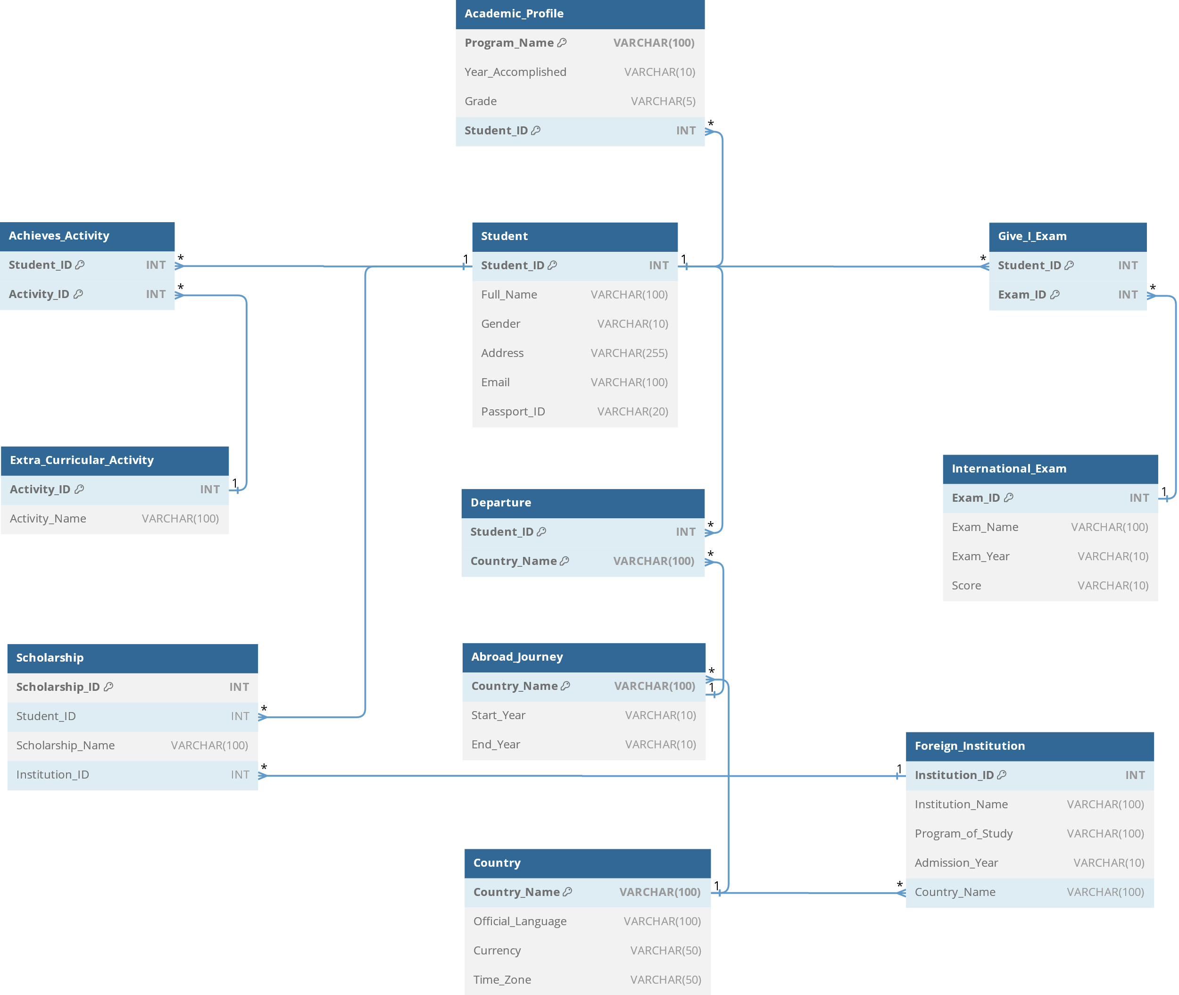
Schema Diagram

Slide 7
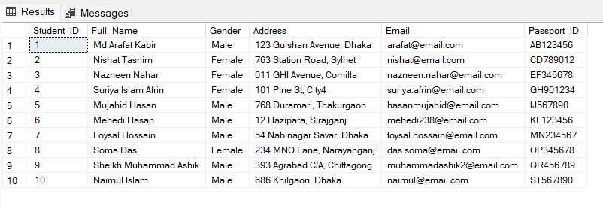

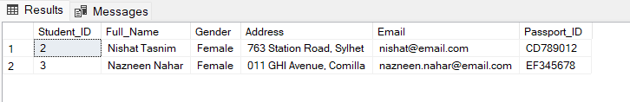
Query Question
Retrieve the full list of students.
SELECT *
FROM Student;
2. Count the total number of students in the "Student" table.
SELECT COUNT(*) AS Total_Students
FROM Student;
3. Retrieve all the female students whose full names start with the letter 'N’.
SELECT * FROM Student
WHERE Full_name LIKE 'N%' AND Gender = 'Female';

Slide 8

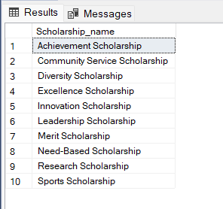


4. Count the number of students who received scholarships.
SELECT COUNT(DISTINCT Student_ID) AS Scholarship_Count
FROM Scholarship;
6. Retrieve a list of distinct scholarship names from the Scholarship table, sorted in alphabetical order.
SELECT DISTINCT Scholarship_name
FROM Scholarship ORDER BY Scholarship_Name;
5. Find the highest score among all stidents in international exam.
SELECT MAX CAST(Score AS FLOAT) Maximum_International_Exam_Score
FROM International Exam

Slide 9
CEP MAPPING
Knowledge Profile (K’s) addressed through our project and mapping among K’s, CO (Course Outcomes), PO (Program Outcomes):
K’s | Attributes | How K’s are Addressed Through Our Project | CO | PO
K2 | Mathematics | Mathematics and statistics knowledge is necessary for various aspects of the project. This includes data analysis, ensuring data accuracy, and making informed decisions based on statistical information. Proficiency in mathematics and statistics is essential for effectively managing the database and scholarship data. | CO2, CO3, CO4 | PO1, PO3, PO5, PO6, PO7, PO8
K3 | Engineering Fundamentals | In the context of the project, engineering fundamentals refer to a deep understanding of database fundamentals, which is essential for designing a suitable database model to manage information related to Bangladeshi students studying abroad. This knowledge ensures that the database is structured efficiently and securely. | CO2, CO3, CO4 | PO1
K4 | Specialist Knowledge | Specialist knowledge pertains to expertise related to scholarship management. The project requires knowledge about how scholarships are managed, allocated, and tracked for Bangladeshi students studying abroad. This knowledge helps in implementing the scholarship component of the database system, ensuring it caters to the needs of stakeholders. | CO2, CO3, CO4 | PO1
K5 | Engineering Design | Engineering design knowledge involves the use of ER (Entity-Relationship) diagrams and schema diagrams to design the database. These design elements are essential for organizing and structuring the database to efficiently store and retrieve information. Proper design contributes to the success of the project by ensuring data accuracy and accessibility. | CO3, CO4 | PO3, PO5
K6 | Engineering Practice | Engineering practice refers to the practical implementation of the project using SQL in SQL Server Management Studio. This knowledge is necessary for creating and maintaining the database, ensuring data integrity, and optimizing performance. Implementing the project successfully relies on a strong grasp of SQL and database management practices. | CO1, CO2, CO5 | PO5
K7 | Comprehension | Comprehension knowledge extends to understanding the positive societal impact achieved by facilitating access to education data. It involves recognizing the role the project plays in providing essential information about Bangladeshi students studying abroad. This knowledge ensures that the project aligns with its societal impact goals. | CO6, CO7 | PO6, PO7, PO8

Slide 10
Complex Engineering Problems (P’s) addressed through our project and mapping among P’s, CO (Course Outcomes), PO (Program Outcomes):
P’s | Attributes | How P’s are Addressed Through Our Project | CO | PO
P1 | Depth of Knowledge Required | The project addresses complex engineering problems by requiring in-depth knowledge in various areas, including database fundamentals, scholarship management, ER and schema diagrams, SQL implementation, and societal impact. These aspects are essential for solving the complex problems of efficiently managing information about students studying abroad. The successful resolution of these problems aligns with the project's core objectives. | CO1, CO2, CO3, CO4, CO5 | PO1, PO3, PO5, PO6, PO7, PO8
P3 | Depth of Analysis Required | The project calls for further analysis to optimize integrity constraints and efficiency in managing the database. This analysis ensures that the database remains robust and that the information is accurate and accessible. These optimizations contribute to achieving the desired project outcomes. | CO3, CO4, CO5 | PO6, PO7, PO8, PO12
P6 | Extent of Stakeholders | The project caters to the needs of multiple stakeholders, primarily Bangladeshi students studying abroad and the government institution seeking access to their data. These stakeholders have diverse requirements related to scholarship management, educational journeys, and academic profiles. Addressing these diverse needs aligns with complex engineering problems and helps achieve the project objectives. | CO6, CO7 | PO9, PO10
P7 | Interdependence | To address complex problems efficiently, the project breaks down the database into smaller tables. This modular approach enables better problem-solving, as it allows for a more focused and systematic approach to data management. Breaking down the project into smaller components aligns with specific project objectives. | CO8 | PO11
Complex Engineering Activities (A’s) addressed through our project and mapping among A’s, CO (Course Outcomes), PO (Program Outcomes):
A’s | Attributes | How A’s are Addressed Through Our Project | CO | PO
A1 | Range of Resources | The project involves utilizing a diverse range of resources, including data, technologies, people, and financial investments, to build and maintain the database system. This comprehensive approach ensures that the project has the necessary resources to succeed and meet its objectives. The efficient utilization of these resources contributes to the project's success. | CO8 | PO11
A4 | Consequences for Society and Environment | The project has positive consequences for society by improving the management of information related to Bangladeshi students studying abroad. It contributes to educational and societal development, as it enhances access to education data and scholarship information. This positive societal impact aligns with several project objectives. | CO6 | PO6, PO7, PO8
A5 | Familiarity | One of the primary complex engineering activities of the project is the development of an online system for managing information related to Bangladeshi students studying abroad. This activity requires familiarity with database design and management practices, software development, and user interface design. Ensuring that the project team is familiar with these activities contributes to project success. | CO9

Slide 11


Team Members
MD. Mujahid Hasan​
Suriya Islam Afrin​
Nazneen Nahar​
REG : 21201126
REG : 21201139
REG : 21201145
Md. Arafat kabir​
Nishat TAsnim​
REG : 21201146
REG : 21201149

Slide 12
Thank You For Your Attention
INSTUTION : UNIVERSITY OF ASIA PACIFIC
DEPARTMENT : COMPUTER SCIENCE AND ENGINEERING
SEMESTER : SPRING (2ND YEAR, 2ND SEMESTER)
12

